Slide 1



Slide 2
CERTIFICATE
Seat No :- 21215
This is to certify that, the Mini Project entitled
“ Snake Game”
Has been successfully completed.
By
Ashish Bhagwatilal Purohit.
Semester I-II Class: MCA Div.: A
M.C.A. (Master of Computer Application)
Academic Year 2020-2021
Project Guide Name
Shubham Wadpalliwar Sir
Ashok Deokar Sir
HOD, MCA
Dr. E,B,Khedkar
Director

Slide 3
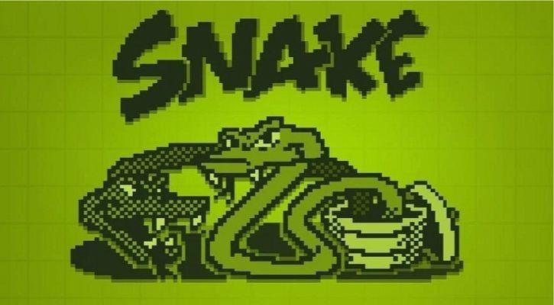
*DR. D Y PATIL SCHOOL OF MCA *
Project Presentation On : “Snake Game”.
Guided By: Prof. Shubham Wadpalliwar.
Presented By :- Ashish Bhagwatilal Purohit.
Division :- A.
Roll No:- 47.

Slide 4
INDEX
Sr No. | Chapter Name | Page No.
1. | Chapter 1: Introduction
1.1 | Introduction
1.2 | Objective
1.3 | Scope of Project.
1.4 | Technology & Tools Used
1.5 | Structure of the Project
1.6 | Module Specification

Slide 5
2 | Chapter 2: Analysis & Design
2.1 | Use Case Diagram
2.2 | Sequence Diagram
2.3 | Class Diagram.
2.4 | Activity Diagram.
3. | Chapter 3 : Screen Shots
4. | Chapter 4 : Coding
5. | Chapter 5 : Bibliography

Slide 6
SOFTWARE REQUIREMENTS
SPECIFICATIONS.
FOR
“SNAKE GAME”
JAVA PROGRAMMING
Presented By :- Ashish Bhagwatilal Purohit.

Slide 7
1.1 INTRODUCTION :-
The Following is an example game written in Java based on the game called ‘Snake’ which has been
around since the earliest days of Home Computing and has re-emerged in recent years on Mobile Phones.
Snake is a classic video game from the late 70s. The basic goal is to navigate a snake and eat as many
Apples as possible without touching the walls or the snake’s body.
It’s a Snake Game where you play VS The computer. This is small game. In this if the player has to change the
direction of the snake for getting a food for snake.
It isn’t the world greatest game, but it does give you an idea of what you can achieve with a relatively simple
Java Program.
Presented By :- Ashish Bhagwatilal Purohit.

Slide 8
1.2 OBJECTIVE :-
The aim of the game is to collect the dots ( Food) and avoid the obstacles ( crosses , borders and
the snake itself ).
As you collect the food, the snake gets longer, so increasing your likelihood of crashing into yourself.
When you have collected enough food, you progress on to the amount of food to collect your pro-
gress through the level gets larger.
Create a snake game that will have all the functionality of traditional snake games
This game aims to change the way people think of traditional snake game. Because we will provide
game with different graphics and also provide snake in different random colours.
Presented By :- Ashish Bhagwatilal Purohit.

Slide 9
1.3 SCOPE :-
To provide the valuable experience of the design and implementation of a large program.
The Project aims to bring the fun and simplicity of a Snake Game to the User to remind the old era
of the mobile phone where this game used to be on hike.
This document goes over the electrical components and software required for the game; how they
work and interact with each other.
The requirements of the project, general theory of operation and then the specifics of how this was
accomplished will be detailed.
The classic game we all were addicted to play on the Cellphones.
Presented By :- Ashish Bhagwatilal Purohit.

Slide 10
1.4 TECHNOLOGY AND TOOLS TO BE USED:-
Software Requirements:
Operating System : Windows.
Application Software : Eclipse IDE 64 bit.
Language : Java.
Hardware Requirements:
Hard Disk : 100MB.
Ram : 128Mb.
Processor : Any Pentium version.
Presented By :- Ashish Bhagwatilal Purohit.

Slide 11
1.5 STRUCTURE OF THE PROJECT:-
This snake Game is just similar to games which are found under mobile games section.
It uses the concept of graphics to display the menu items and all objects on a single screen.
Players will able to check their result after games get over.
The score section will display the total score of the player, game level and maze which has
been used.
The object snake position has set as a random, so whenever player will start the game, the snake
will appear at random location every time.
The number keys UP,DOWN,LEFT,RIGHT has been set within the programs to move the snake to
right, left, top and bottom respectively.
Press ‘Esc’ to exit the game at anytime. Also there will be a Pause button If you get any emergency
and you need to pause to continue after some minutes.
Presented By :- Ashish Bhagwatilal Purohit.

Slide 12
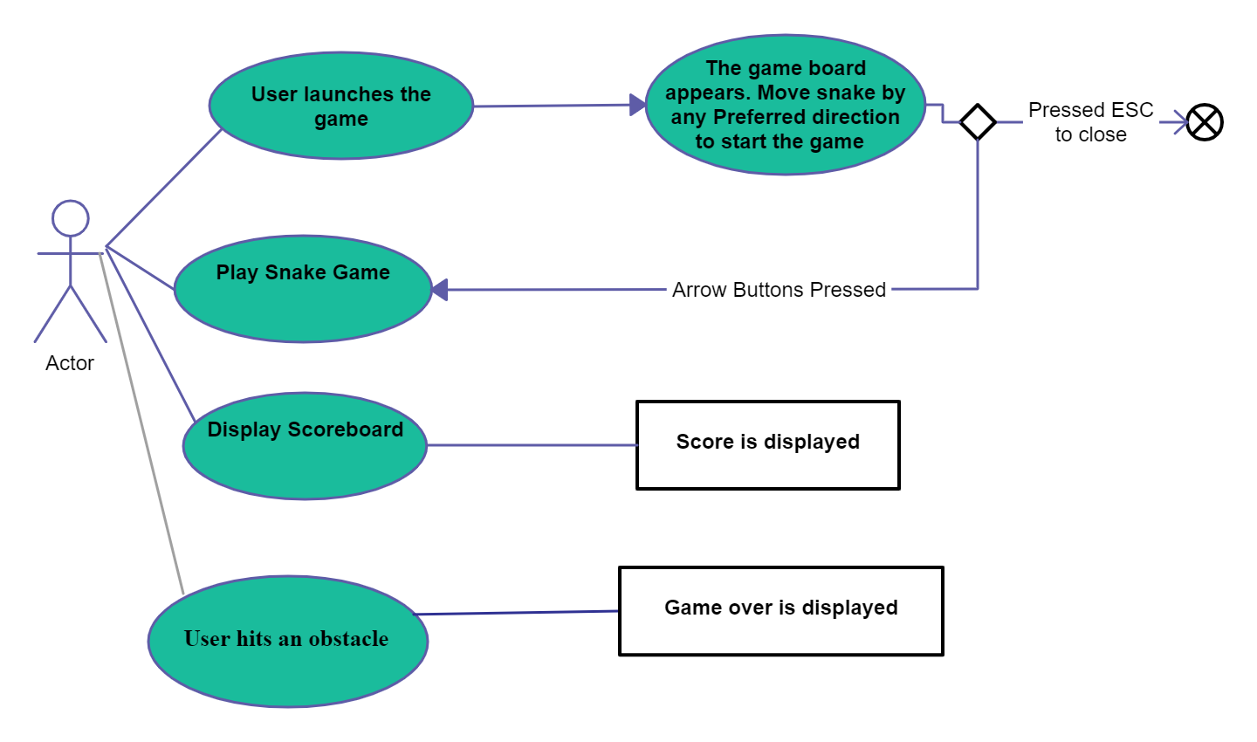
1.6 UML DIAGRAM : -
1.6.1 USECASE DIAGRAM.
Presented By :- Ashish Bhagwatilal Purohit.

Slide 13
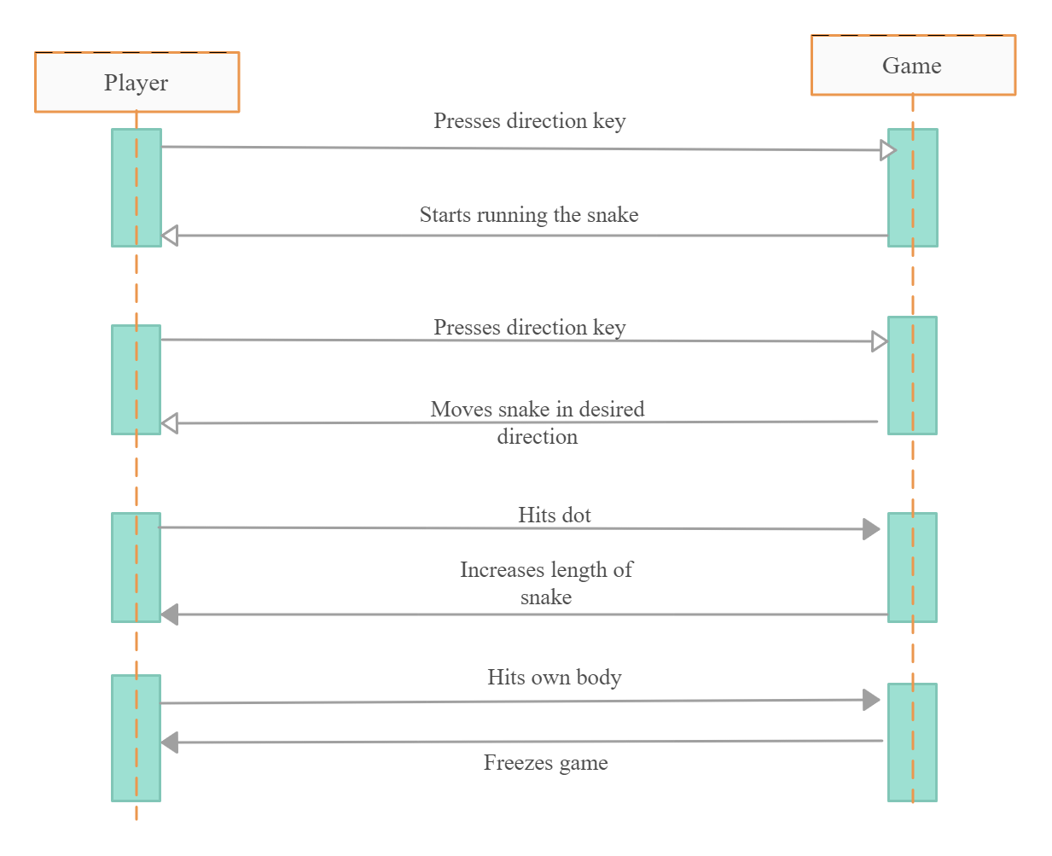
1.6.2 SEQUENCE DIAGRAM :-
Presented By :- Ashish Bhagwatilal Purohit.

Slide 14
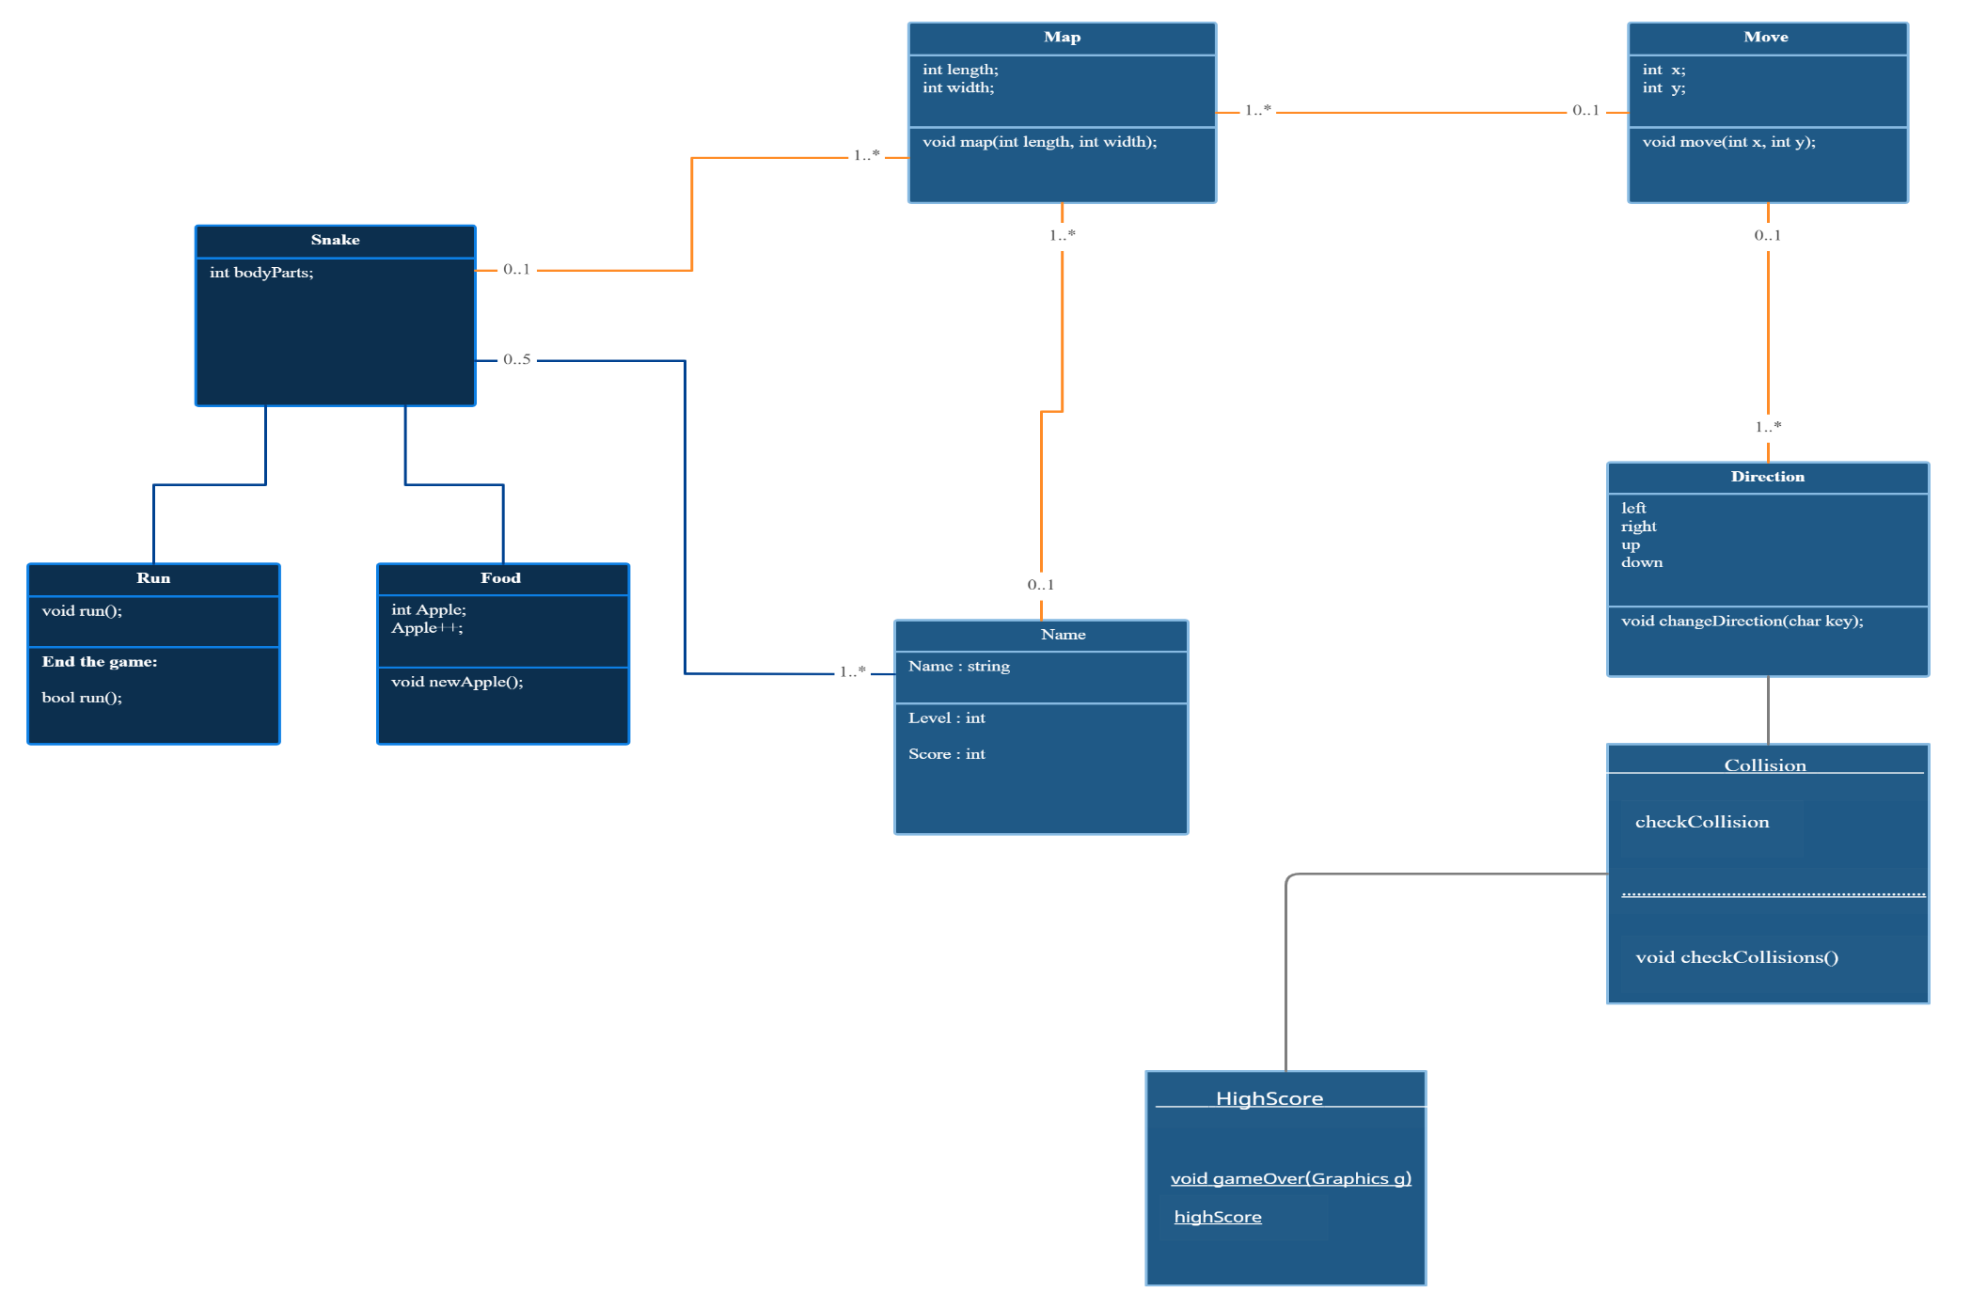
1.6.3 CLASS DIAGRAM : -

Slide 15
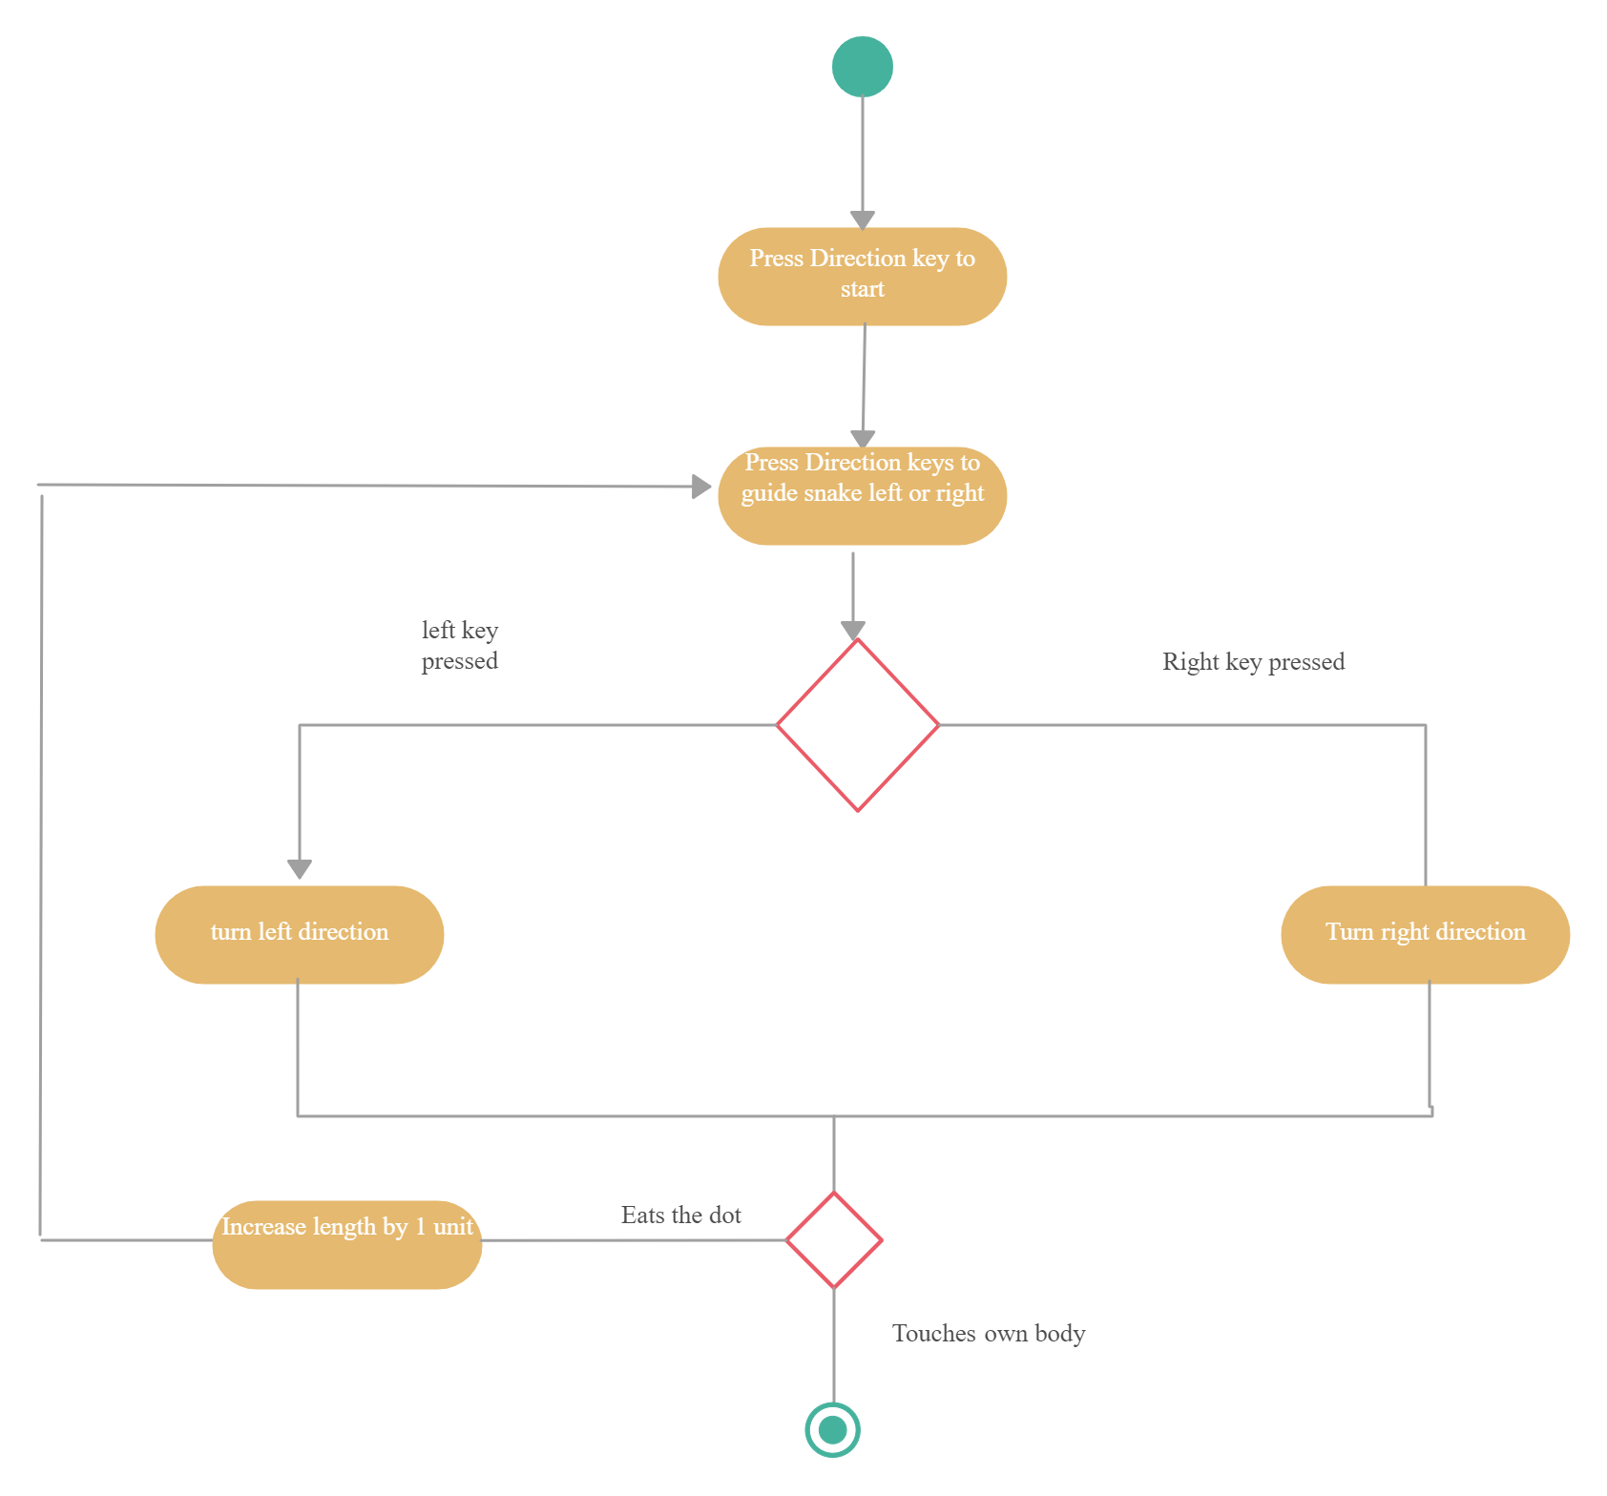
1.6.4 ACTIVITY DIAGRAM : -
Presented By :- Ashish Bhagwatilal Purohit.

Slide 16
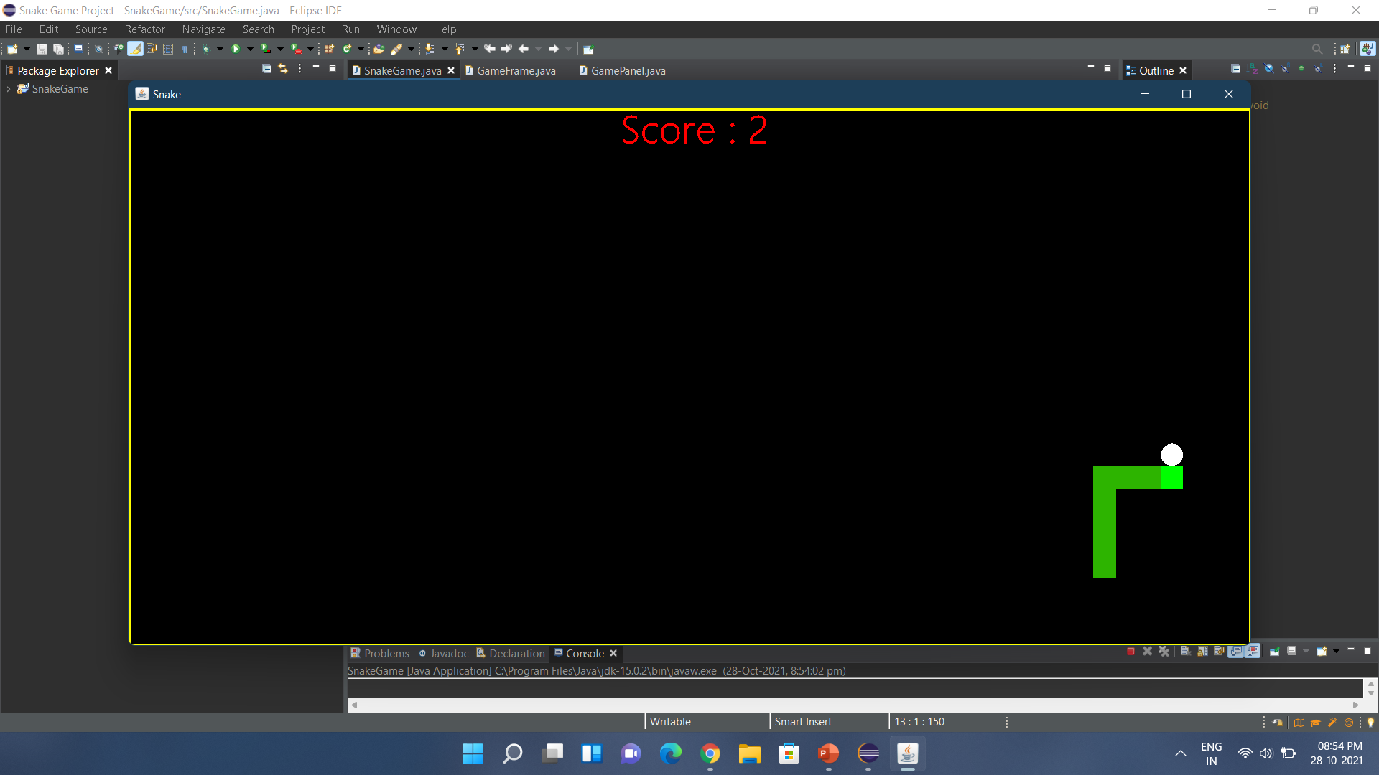
Screenshots :-
3.1 Snake first Score

Slide 17
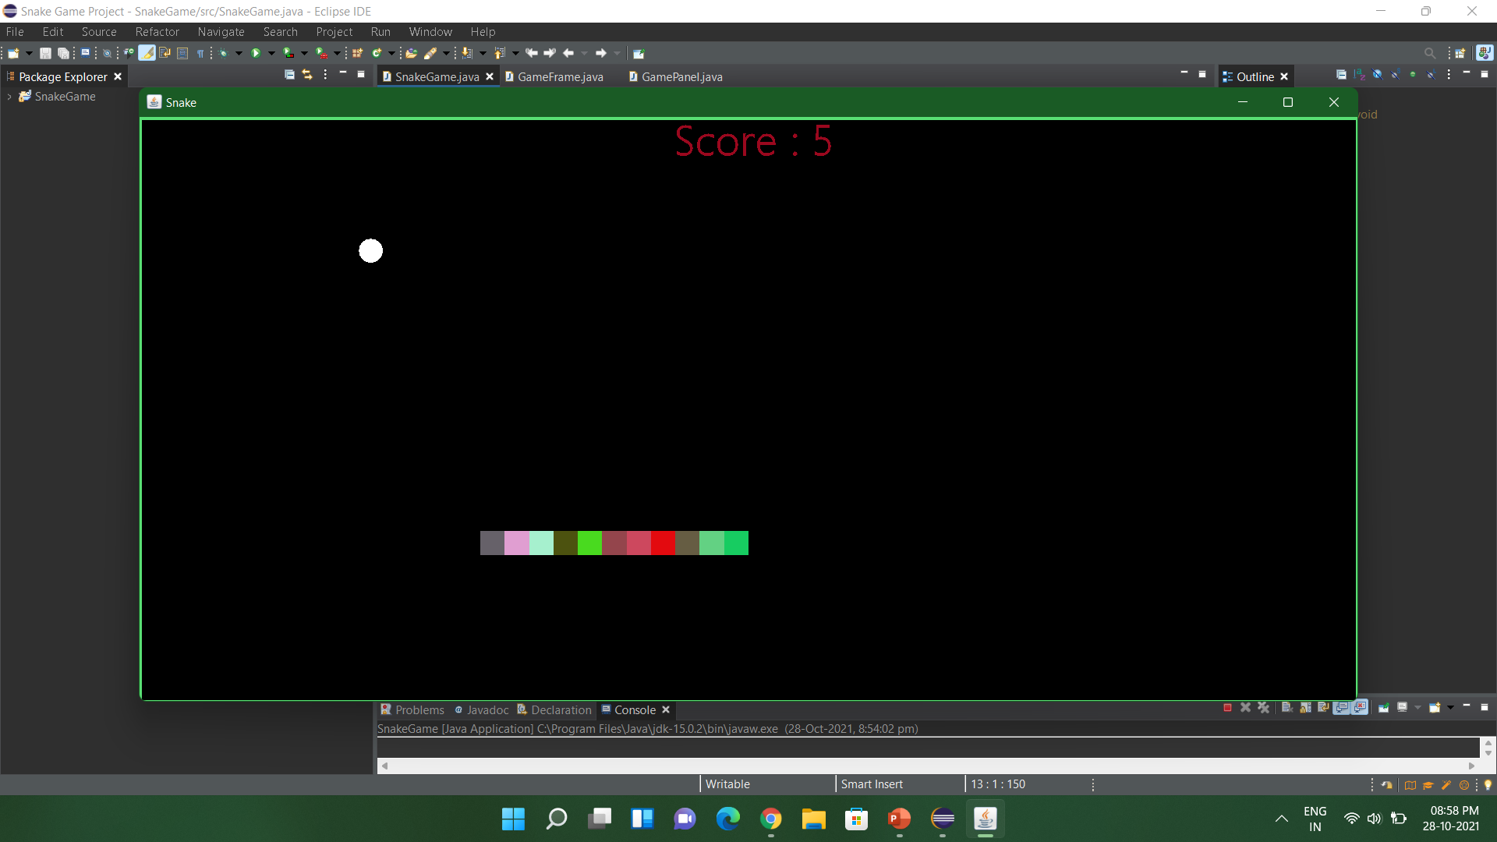
3.2 Every 5 Score The snake, score and border color changes to RGB.
also the speed of snake Increases.

Slide 18
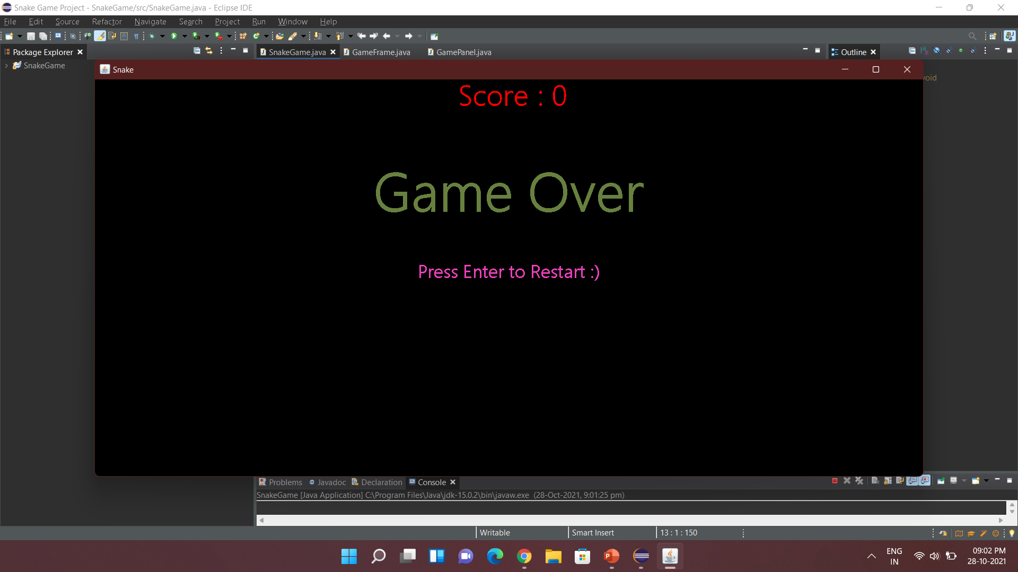
3.3 Game Over & Restart Button & High Score.

Slide 19
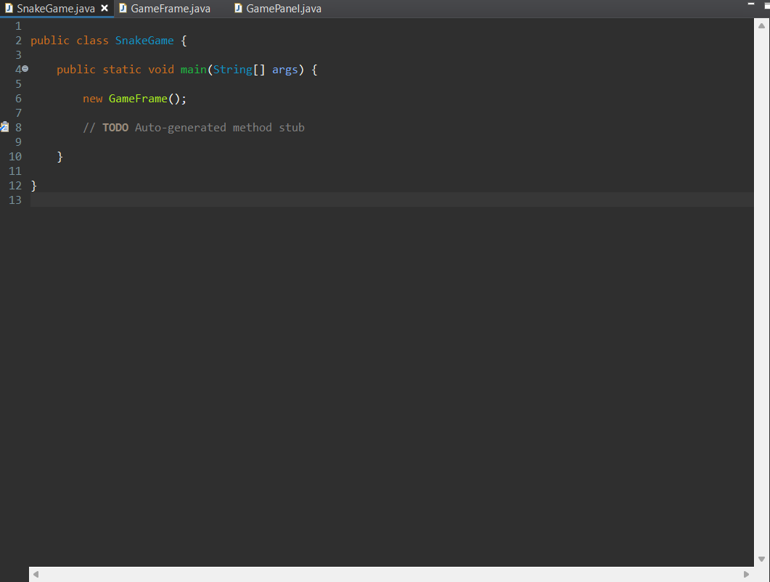
Chapter 4 : Coding
4.1 SnakeGame Main Class

Slide 20
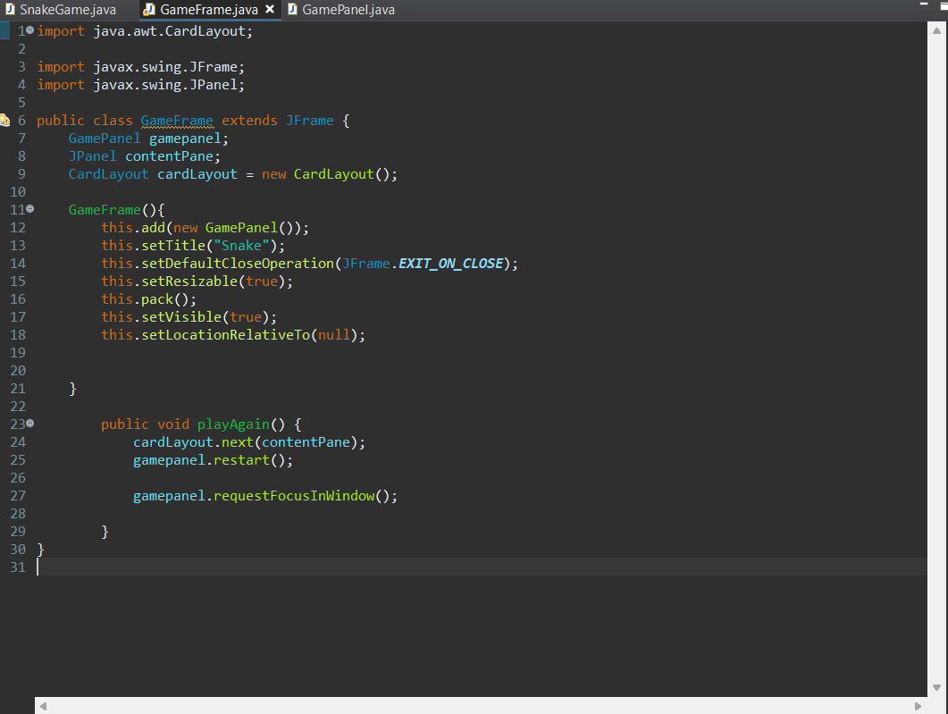
4.2 GameFrame Class

Slide 21
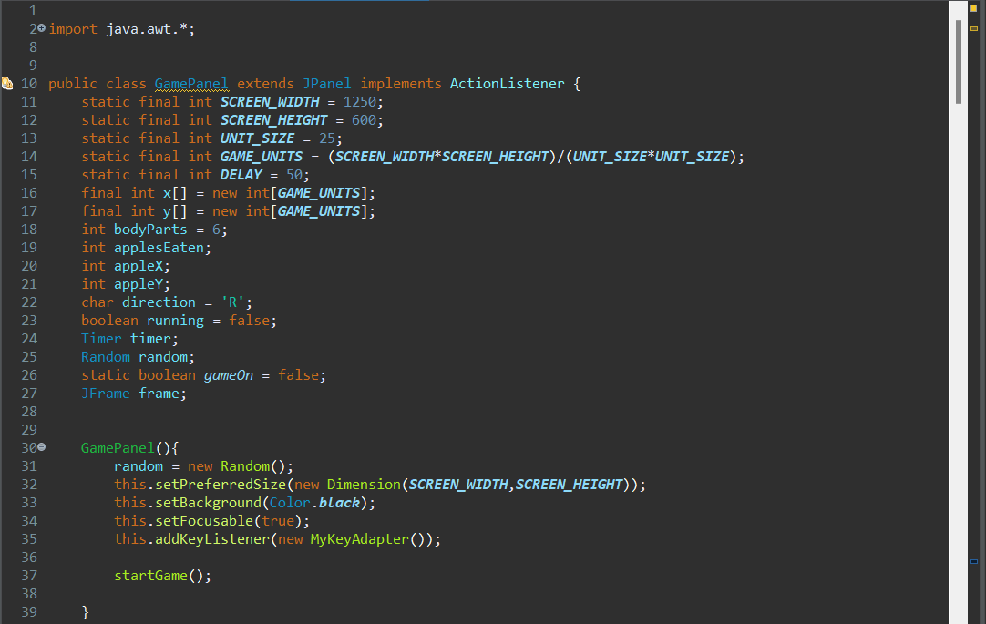
4.3 GamePanel Class
Assigned Variables

Slide 22
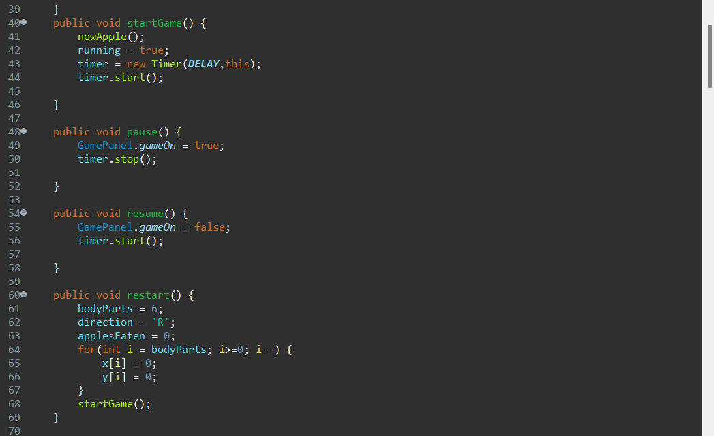
Code contains start pause restart

Slide 23
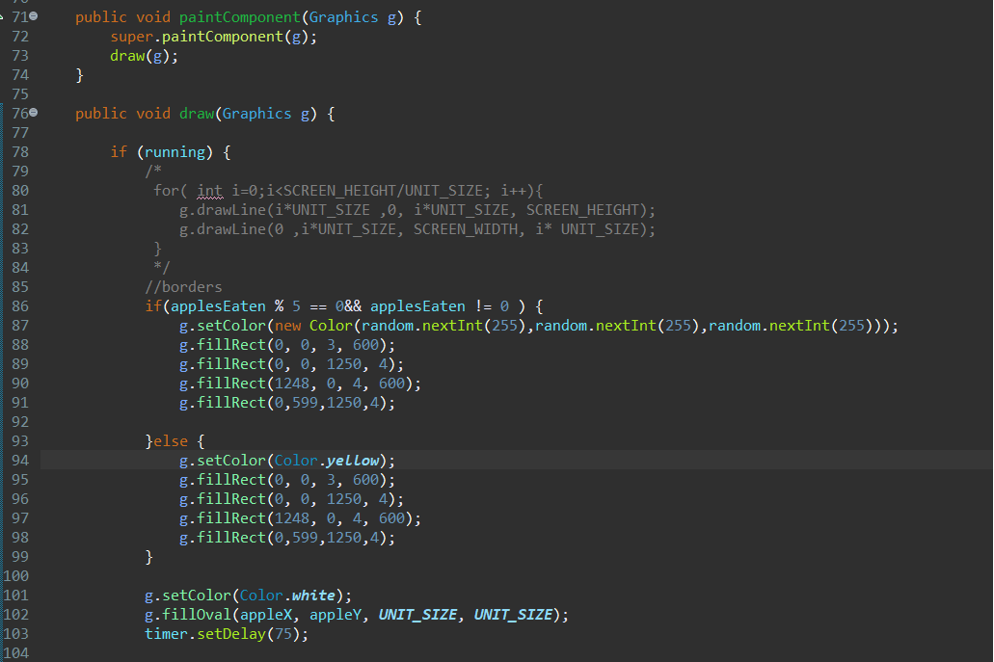
Code Contains Every 5 Score RGB colors at border, Score, Snake &
also the color of BALL

Slide 24
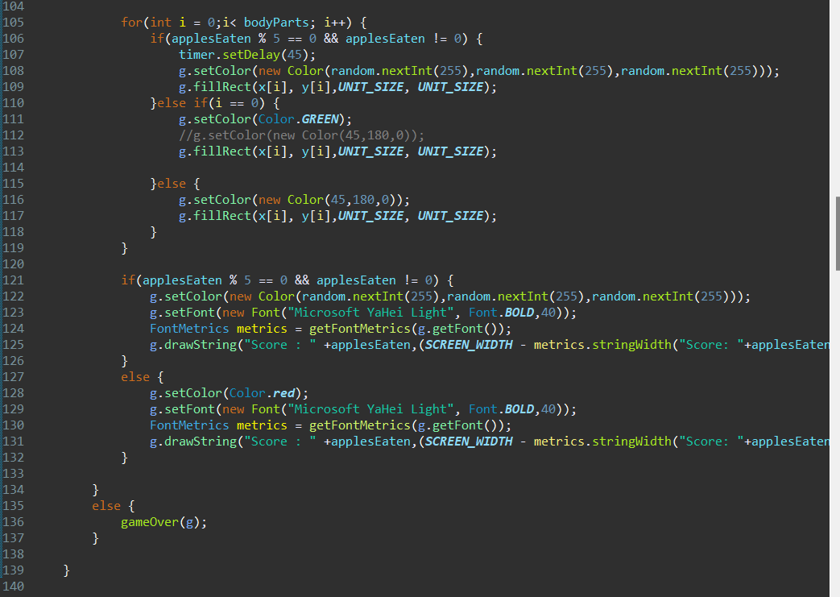
Code contains Snake RGB color Change & Score Color Change

Slide 25
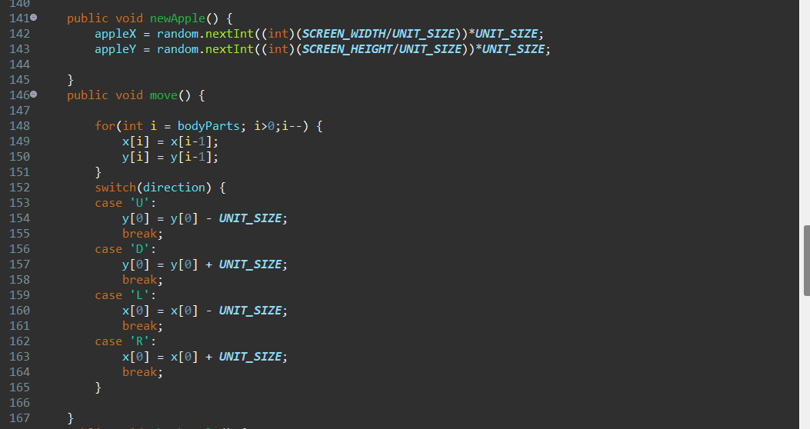
Code Contains The Random position the Apples Arrives &
the Key bindings of the Snake.

Slide 26
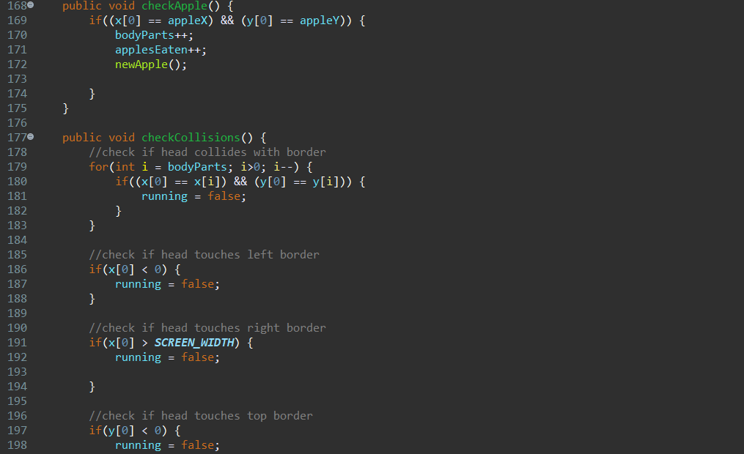
Code Contains Snake Increasing Size when the Apples Eaten & The Collision of Snake
through borders or through his own body

Slide 27
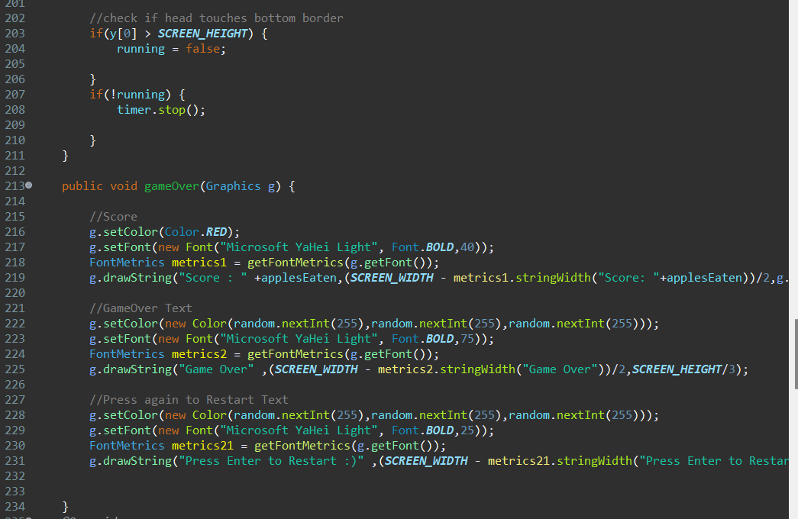
Code contains the not running of Snake & the GameOver & Score Color of Graphics
& the Restart Graphics of the Game

Slide 28
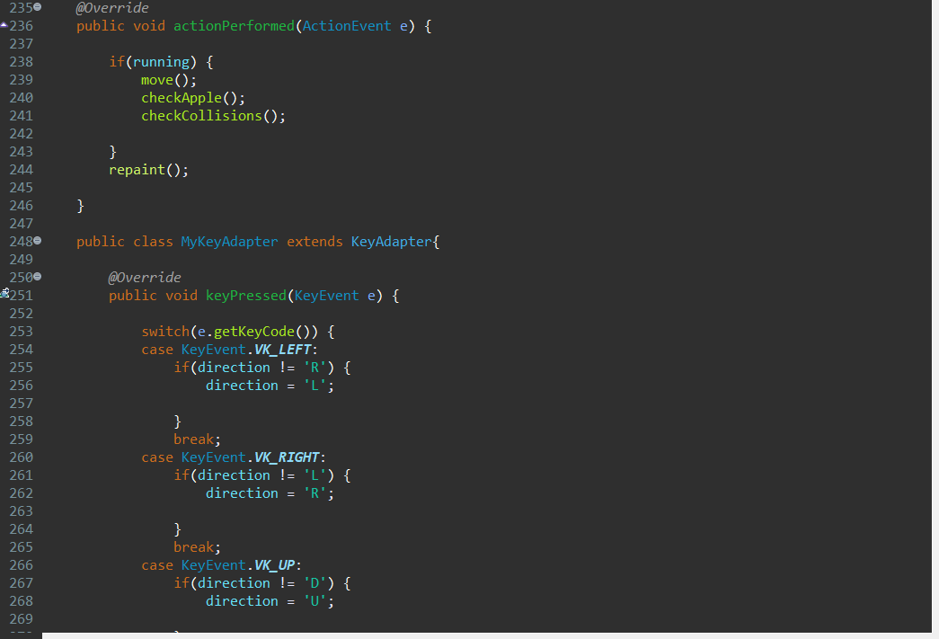
Code Contains Override of function & Key Bindings and Action of Keys.

Slide 29
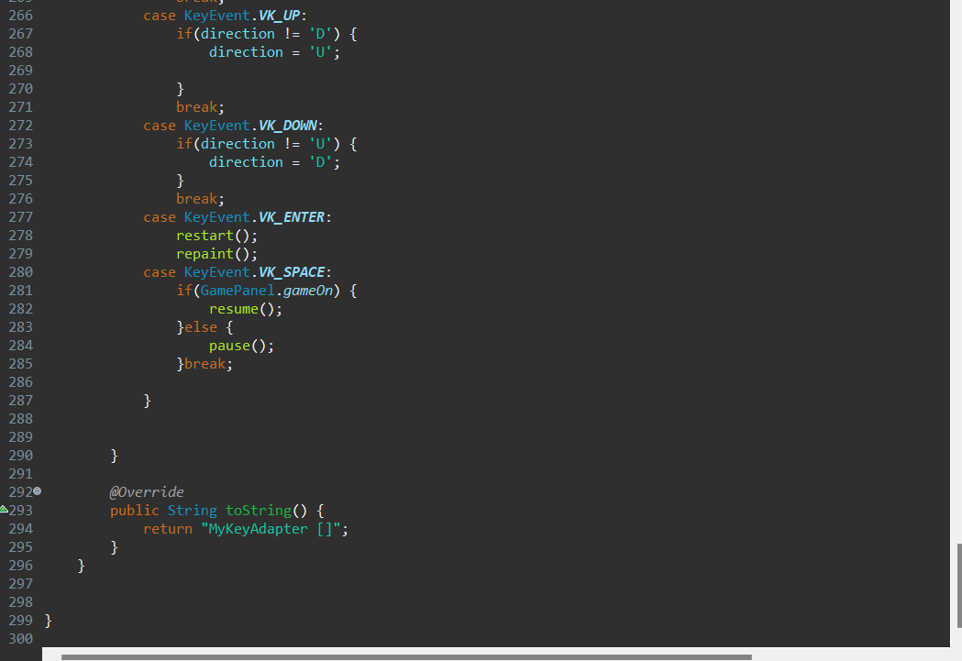
Code Contains Key Binding & The Action of keys.

Slide 30
Chapter 5 : Bibliography
https://zetcode.com/javagames/snake/
https://github.com/janbodnar/Java-Snake-Game

Slide 31
THANK YOU.

